Slide 1
A Minor Project mid-term Presentation On
ELabX
Under the supervision of
Amit Srivastava
June 24, 2023
➢Abhilekh Gautam ➢Aishu Gyawali ➢Bishal Poudel ➢Riya Pant

Slide 2
Problem statement
The syllabus for the laboratory is not completed.
Inadequate Interactive Learning.
Lack of adequate attention to each student and tracking their progress individually.

Slide 3
INTRODUCTION
A lab management system to improve the quality of lab classes in the context of programming.
A Digital course management system with topics and practice questions related to each subject offered by an institute.

Slide 4
To develop a system that helps to keep track of students' laboratory progress.
To develop a system that provides users with a sandboxed environment where they can run and compile the code relative to the course they enrolled in.
Project objectives:

Slide 5
Scope and limitation
Students don't need to be physically present in the college for their lab work as they can easily complete their work from home.
This product can be easily expanded as a college or school course management system.
It will help in progress tracking and grading for students.
Limitation: lacks compatibility with subjects related to databases and other non-programming faculties such as civil engineering, architecture engineering, etc.

Slide 6




Existing systems
W3School
Sakai
Programiz
Rust playground

Slide 7



















Tools and Technology

Slide 8
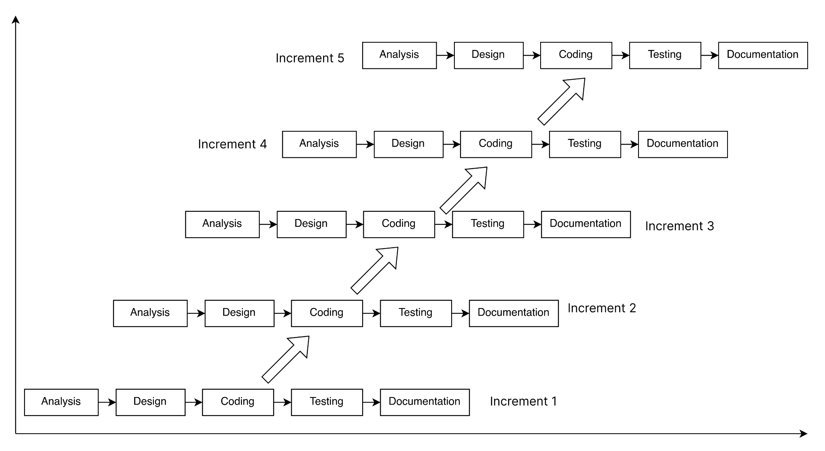
METHODOLOGY
Incremental model

Slide 9
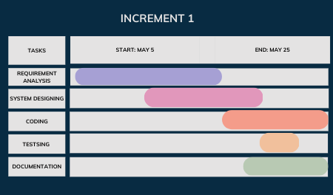
Increment 1
Gather requirements of the system and review existing system
Design high-level system flowchart, use-cases, and UI for code editor as well as other pages
Design architecture for sandboxing, and overall flow of code in wasm module
Create a wasm module for compiling and running the code in the sandbox, with proper error handling
Develop client side for above UI and integrate sandbox
Test the environment
Writing proposal

Slide 10
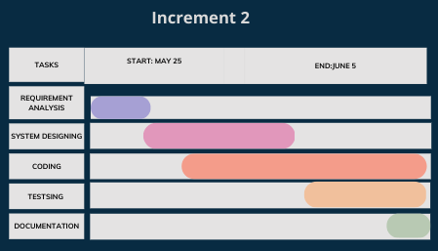
Increment 2
Analysis DBMS for courses and contents for C++
Design schema diagram for courses and UI for a single course
Develop database integration for the course.
Develop APIs for CRUD course contents
containerize
Write test cases for each and every question
Searching for the course (*searching algorithm)
Develop front-end interface for the course and integrate with code editor
Testing the API endpoints

Slide 11
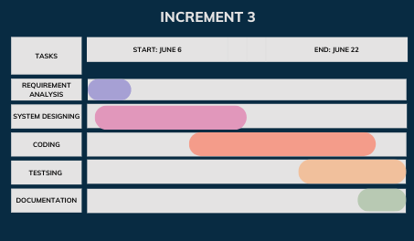
Increment 3
Analysis requirement of user and types
Design database for users and relationship with a course, UI for user views
APIs for different user authentication like a student, teacher
Frontend for login and registration
Validation and verification (*algorithm)
Testing APIs and integration with client-side
Documenting the system

Slide 12
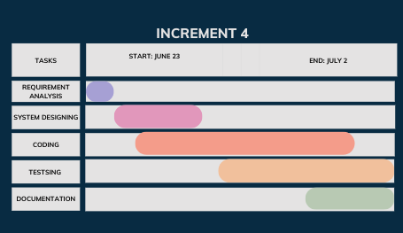
Increment 4
Integration of auto-grading
Tracking the progress of the student (*algorithm)
Self-enrollment
Review the submitted solution by the teacher, and student
Designing and implementing above task in client and server side

Slide 13
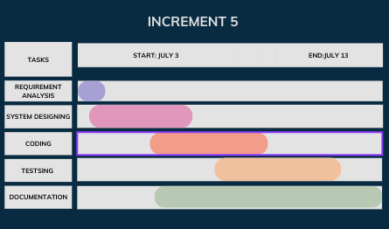
Increment 5
Analysis about the new courses and appropriate CI/CD tools
Design whole system workflow
Extend for more courses
Implement CI/CD along with containerization
Testing for final phase/Integration testing
Document and prepare final report
Improving the product by adding more increments, if needed

Slide 14
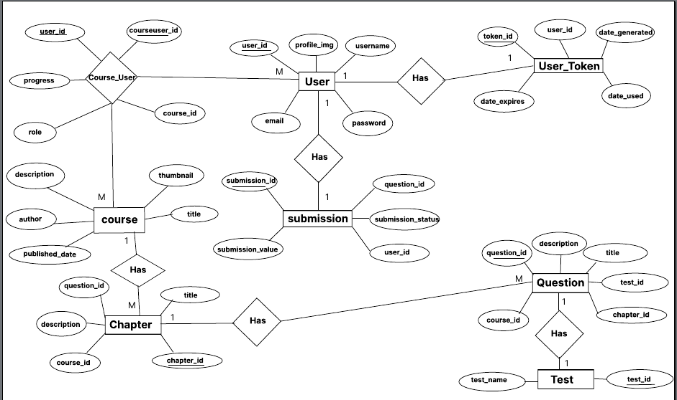
ER Diagram

Slide 15
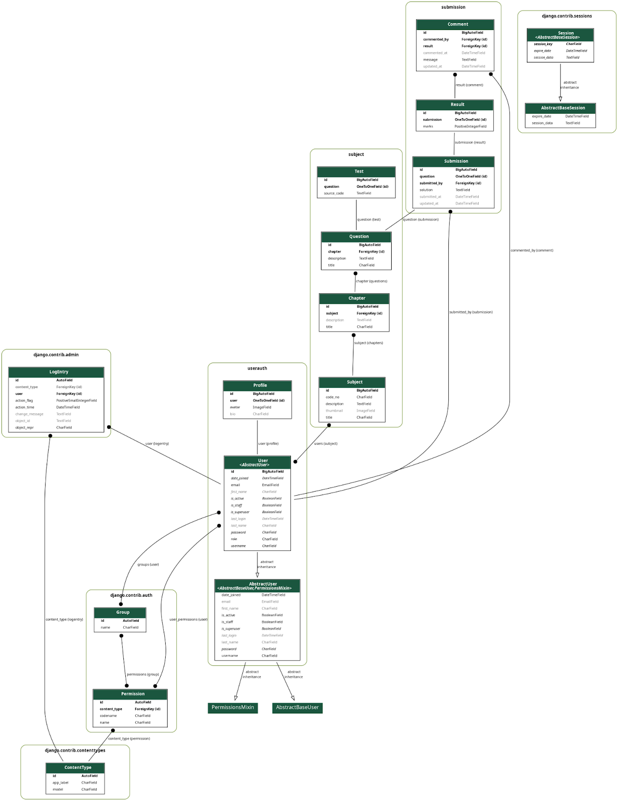
Schema Diagram

Slide 16
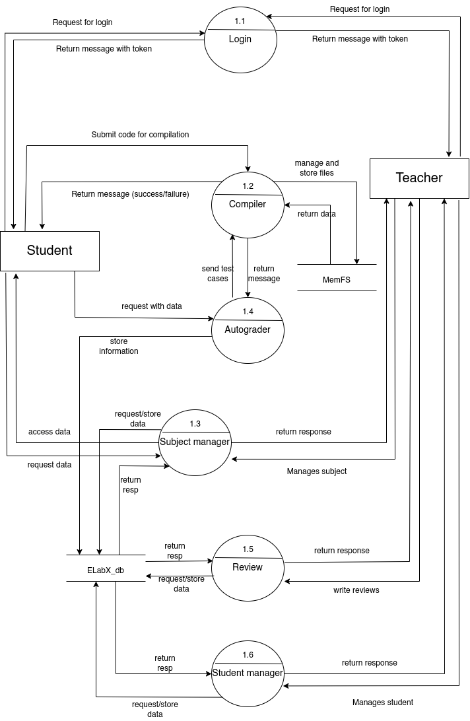
DFD
(Data Flow Diagram)

Slide 17
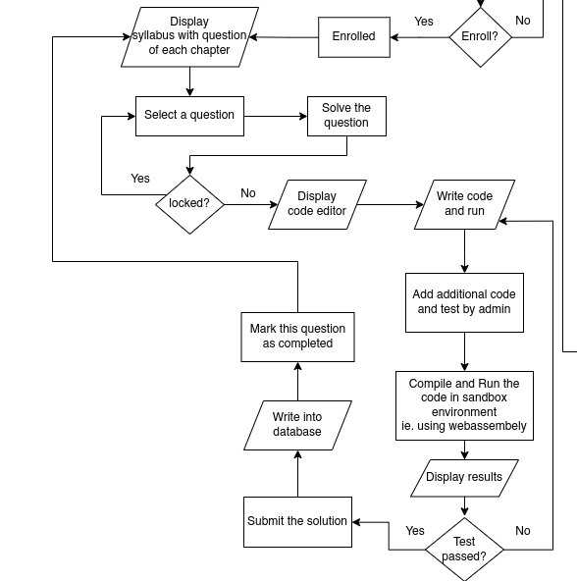

Slide 18
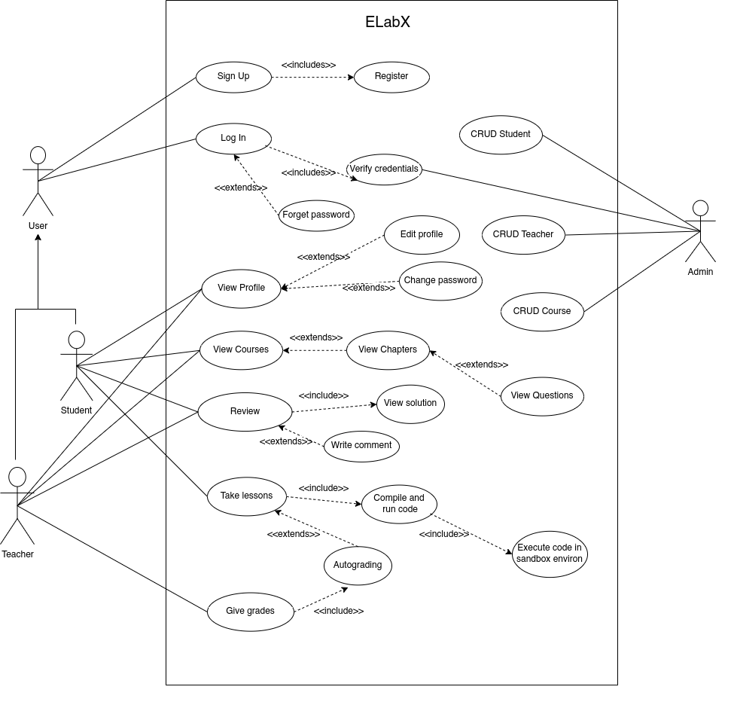
Use Case Diagram

Slide 19
Task Done so far
system design and architecture
Sandbox environment for compiling c++ code
user interface for course management and code editor
Database design and implementation
CRUD APIs for course contents and user authentication
test cases for c++ questions
API testing for course management.
client and server integration

Slide 20

Remaining task
Autograding and Progress Tracking
User interface for login, registration, userprofile and product landing page
Implementation of searching algorithm
Self enrollment and Review section
Integration testing and deployment using CI/CD pipelining

Slide 21
Deliverable
ELabX will be an online platform (ie. web application) that will digitize the lab system by providing a centralized platform for managing and delivering digital learning resources and tools. It provides a sandbox environment for compiling and running students’ code within the browser.

Slide 22
THANK YOU!
© A Minor Project Proposal Report On ELabX - June 14, 2023

Slide 23




The Team
Riya Pant
Abhilekh Gautam
Aishu Gyawali
Bishal Poudel

